Slide 1
Memory
BRAC University
‹#›
Notes:
‹#›

Slide 2
What is Memory Unit?
A memory unit is a collection of registers together with associated circuits needed to transfer information in and out of registers.
Binary cell: An elementary unit of computer storage (i.e. memory register) that can have one or the other of two stable states and can thus store one bit of information.
The memory cell is an electronic circuit that stores one bit of binary information and it must be set to store a logic 1 (high voltage level) and reset to store a logic 0 (low voltage level). Its value is maintained/stored until it is changed by the set/reset process.
A memory unit stores binary information in groups of bits called words.
Communication between memory unit and its environment is achieved through 2 controls( read and write) and 2 external registers (memory address register and memory buffer register).
To communicate with a memory word, its address is transferred to memory address register. Internal circuit then opens the path to select that word. A n-bit address register can specify up to 2^n address. (note: # of address=# of word)
Before writing and after reading information are kept in Memory Buffer registers. In each case, the address register specifies location of writing or reading.
‹#›

Slide 3
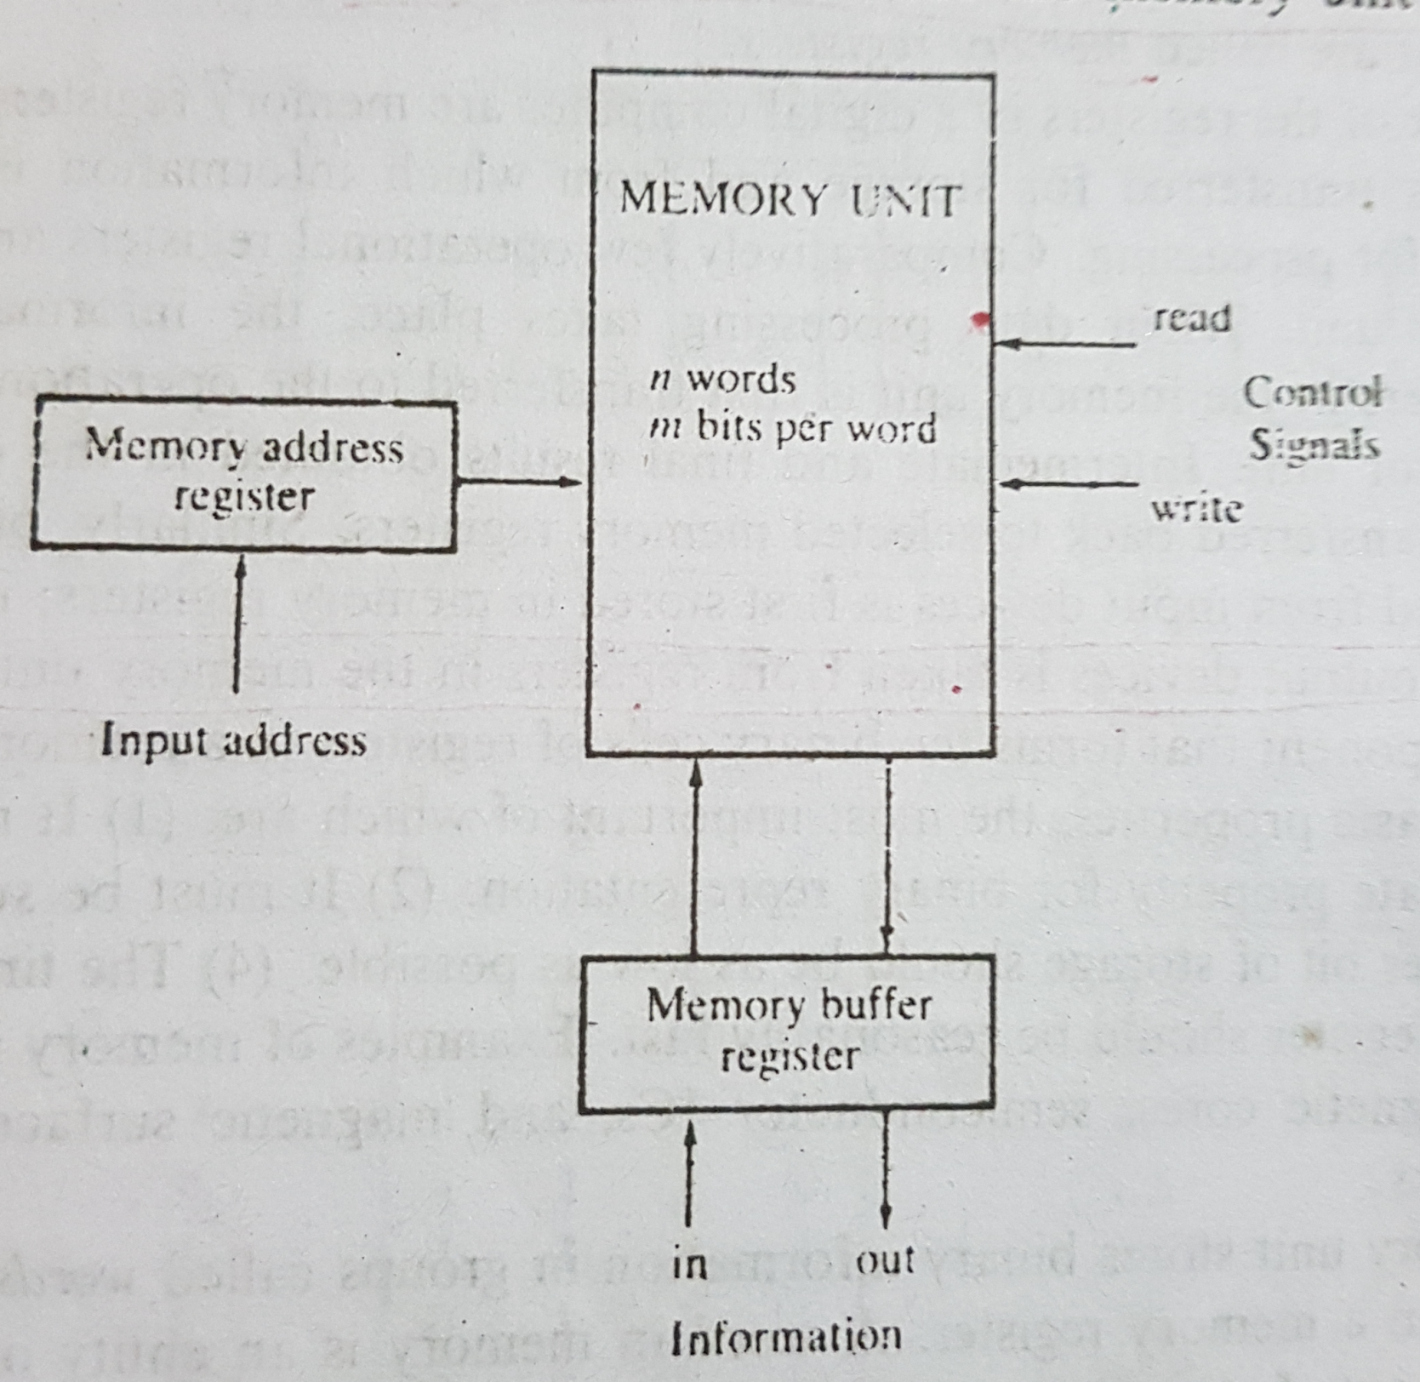
‹#›

Slide 4
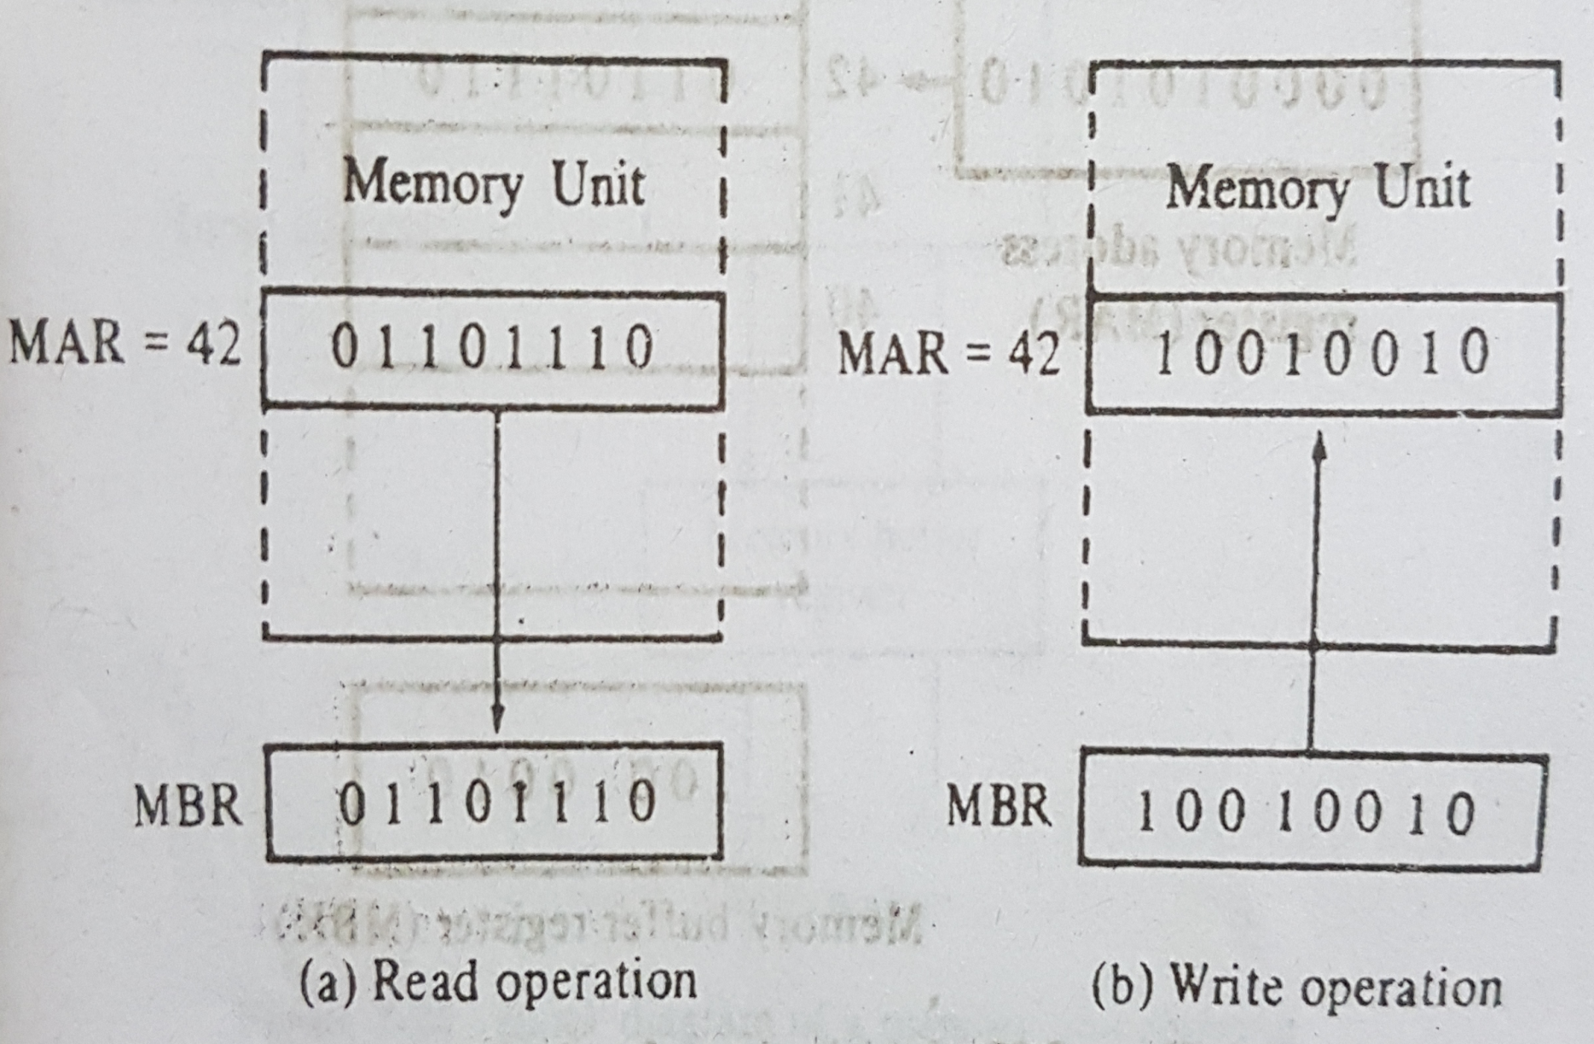
READ WRITE Operation Example
‹#›

Slide 5
Random Access Memory (RAM)
Content of a 1024 x 16-bit memory:
Memory address
binary
decimal
Memory content
0000000000
0000000001
0000000010
:
:
1111111101
1111111110
1111111111
0
1
2
:
:
1021
1022
1023
1011010111011101
1010000110000110
0010011101110001
:
:
1110010101010010
0011111010101110
1011000110010101
‹#›
Notes:
‹#›

Slide 6
Random Access Memory (RAM)
The data consists of n lines (for n-bit words). Data input lines provide the information to be stored (written) into the memory, while data output lines carry the information out (read) from the memory.
The address consists of k lines which specify which word (among the 2^{k} words available) to be selected for reading or writing.
The control lines Read and Write (usually combined into a single control line Read/Write) specifies the direction of transfer of the data.
Example: A memory unit of 1024 words with 8 bit/word needs, 10 address line (i.e. address register must contain 10 FF) and buffer register must have 8 FF to store words transferred in and out of it.
‹#›
Notes:
‹#›

Slide 7
Random Access Memory (RAM)
Block diagram of a memory unit:
n data input lines
n
k
Memory unit
2^{k} words
n bits per word
k address lines
Read/Write
n
n data output lines
‹#›
Notes:
‹#›

Slide 8
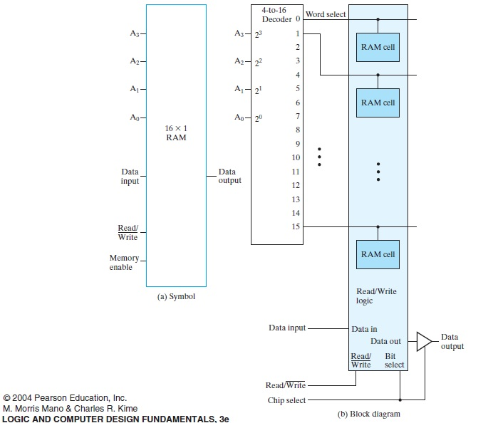
‹#›
Notes:
‹#›

Slide 9
Random Access Memory (RAM)
The Write operation:
Transfers the address of the desired word to the address lines
Transfers the data bits (the word) to be stored in memory to the data input lines
Activates the Write control line (set Read/Write to 0)
The Read operation:
Transfers the address of the desired word to the address lines
Activates the Read control line (set Read/Write to 1)
‹#›
Notes:
‹#›

Slide 10
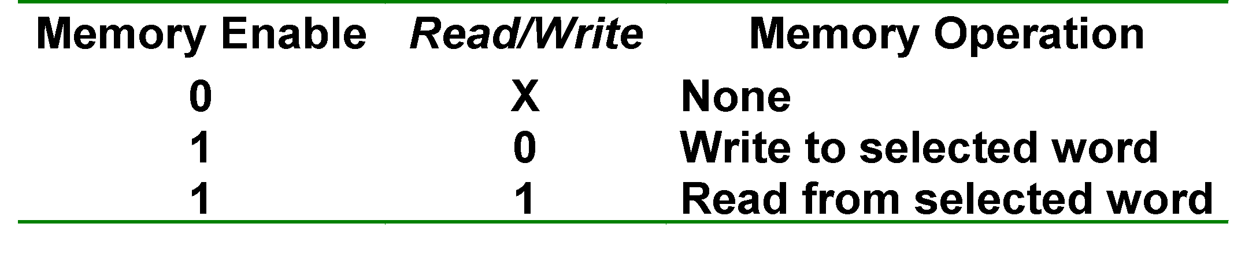
Random Access Memory (RAM)
The Read/Write operation:
Two types of RAM: Static and dynamic.
Static RAMs use flip-flops as the memory cells.
Dynamic RAMs use capacitor charges to represent data. Though simpler in circuitry, they have to be constantly refreshed.
‹#›
Notes:
‹#›

Slide 11
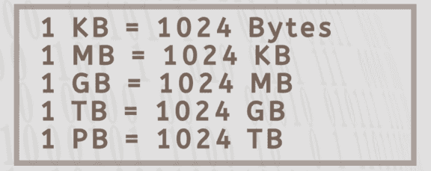
Memory Size
Memory sizes might be specified in bits or byte(=8bit)
Symbol: Bytes (B) and bits(b)
Example, 2^28 b = 2^28/8 B= 2^28/2^3 B=2^25 B= 2^5*2^20 B = 32 MB
 | Prefix | Base 2 | Base 10
K | Kilo | 2^10= 1024 | 10^3=1,000
M | Mega | 2^20 =1,048,576 | 10^6= 1,000,000
G | Giga | 2^30 =1,073,741,824 | 10^9= 1,000,000,000
‹#›

Slide 12
2 formula to remember
Capacity = no. of word x bit/word
No. of word= 2 ^ (address lines)
Capacity= 2^(address line) x bit/word
‹#›

Slide 13
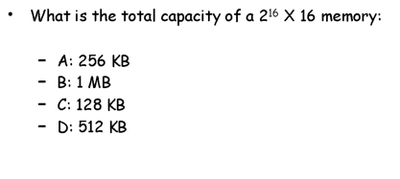
Test your self
Capacity = no. of word x bit/word
No. of word= 2 ^ (address lines)
‹#›

Slide 14
Solution: c
= 2^16 x 16 bits/words
= 1048576 bits
= 1048576/8 bytes
= 131072 bytes
= 131072/1024 KB
= 128 KB
‹#›

Slide 15
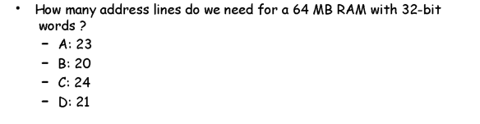
Test yourself
Capacity = no. of word x bit/word
No. of word= 2 ^ (address lines)
‹#›

Slide 16
Solution
Answer: C
Formula:
Capacity = no. of word x bit/word
64MB = no. of word x 32bits/word
no. of word = 64MB / 32 bits/word
= (64x1024x1024x8)(/32[ 1 byte = 2^3 bits]
= 16777216 bits = 2^24 bits
no. of address lines = 24
‹#›

Slide 17
Binary cell
Must be small so that many binary cell (BC) can fit in a small area
Select input enable cell for reading/writing
Read/write determines operation to be preformed on cell. A 1 in read/write input forms a path to the output terminal. A 0 in read/write input, information in the input terminal is transferred into the FF
‹#›

Slide 18
Random Access Memory (RAM)
A single memory cell of the static RAM has the following logic and block diagrams.
Select
Select (inputs)
R
S
Input
Q
Output
Input
BC
Output
Read/Write
Read/Write
Logic diagram
Block diagram
‹#›
Notes:
‹#›

Slide 19
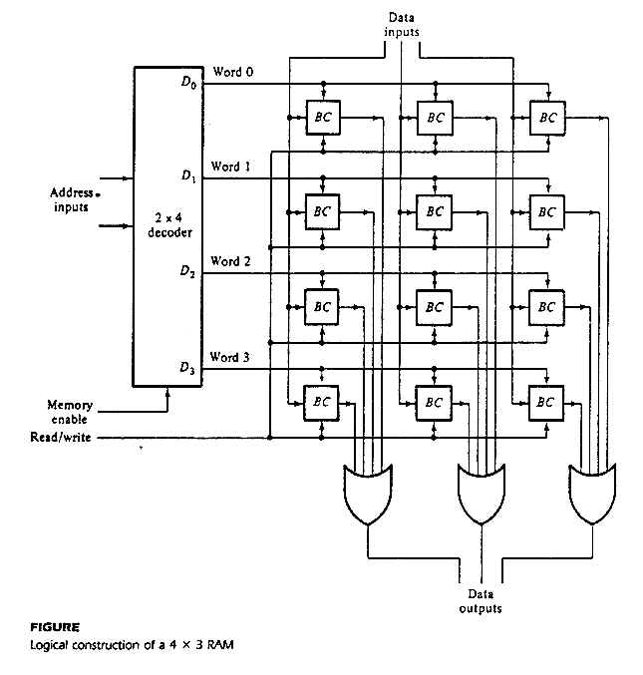
Random Access Memory (RAM)
# of word
Bit/word
Logic construction of a 4 x 3 RAM (with decoder and OR gates):
Select
(inputs)
Input
BC
Output
Read/Write
Since no of word is 4, that would be equivalent to the decoder’s output. Since, the decoder will have 4 outputs, so we should use a 2x4 decoder
‹#›
Notes:
‹#›

Slide 20
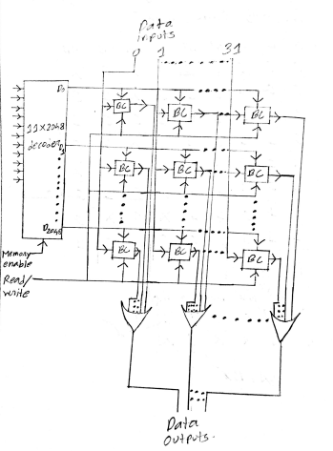
Random Access Memory (RAM)
# of word
Bit/word
Logic construction of a 2048 x 32 RAM (with decoder and OR gates):
‹#›
Notes:
‹#›

Slide 21
Random Access Memory (RAM)
An array of RAM chips: memory chips are combined to form larger memory.
A 1K x 8-bit RAM chip:
RAM 1K x 8
Input data
Address
Chip select
Read/write
8
DATA (8)
ADRS (10)
CS
RW
(8)
8
Output data
10
Block diagram of a 1K x 8 RAM chip
‹#›
Notes:
‹#›

